Slide 1

Image Fusion of Infrared(IR) and Visible images using a novel Hybrid MSD approach
Presented
By
NITIN P KHATAWATE [1DS13CS067]
SHIVPRASAD ACHARI [1DS13CS091]
SOUMIL BISWAS [1DS13CS099]
TANISH V SUGNANI [1DS13CS110]
Under the Guidance of
Dr. Shubha Bhat Mr. Sasidhara Bola
Assoc. Professor Asst. Professor
Dept .of CSE Dept .of CSE
Bangalore Bangalore
Department of Computer Science & Engineering, DSCE

Slide 2
OVERVIEW
The presentation would deal with the following:
Introduction
Objective
Literature survey
Methodology
Architecture Diagram
Flowchart
Experiments
Results
Conclusion
References
Department of Computer Science & Engineering, DSCE

Slide 3
INTRODUCTION
In computer vision, Multi sensor Image fusion is the process of combining relevant information from two or more images into a single image. The resulting image will be more informative than any of the input images.
Since IR sensors are able to capture thermal information in a scene that is not directly seen by human eyes, they can more clearly detect some objects in lowlight, occlusion and adverse weather conditions.
Visible imagery normally provides more details of the scene in the visible spectrum, and also presents more natural intensities and contrasts that are consistent with human visual perception.
In this project, we present a multi scale fusion method to achieve better fusion results for human visual perception.
Department of Computer Science & Engineering, DSCE

Slide 4
l
OBJECTIVE
The main objective is to fuse images, the visible and infrared images, to enhance the information of output image which could be helpful for many applications, especially for surveillance of sensitive border regions to locate enemies particularly in the forest/mountain areas.
PROBLEM STATEMENT
In low light environment, only limited visual information can be captured by CCD cameras under poor lightning conditions, thus making it difficult to do surveillance only by visual sensor. Therefore in this work, an image fusion technique is proposed that fuses low-light visible images and IR images capturing the same scene for better image understanding.
Department of Computer Science & Engineering, DSCE

Slide 5
l
LITERATURE SURVEY
Wei Gan, Xiaohong Wu, “Infrared and visible image fusion with the use of multi-scale edge preserving decomposition and guided image filter”
The multi-scale edge-preserving decomposition can effectively extract the useful information from the source images, whereas the guided image filter can eliminate artifacts. The proposed fusion scheme achieves the best results by take the advantages of multi-scale decomposition and guided filter. In addition, PC rather than Laplace operator is adopted in this study to obtain better saliency maps, which improves the performance of the proposed method.
Y. Chai, H.F. Li, J.F. Qu, “Image fusion scheme using a novel dual-channel PCNN in lifting stationary wavelet domain”
The proposed dual-PCNN is simple and effective, it can put out the fused image directly. In the proposed algorithm, a novel sum-modified-laplacian (NSML), which stands for edge features in low-frequency sub-images in LSWT domain, is used to motivate adaptive PCNN neurons.
Department of Computer Science & Engineering, DSCE

Slide 6
l
LITERATURE SURVEY
Weiwei Kong, Longjun Zhang, Yang Lei, “Novel fusion method for visible light and infrared images based on NSST– SF–PCNN”
NSST owns much lower computational costs and better sparse representations. Then, traditional SCM is improved to be ISCM to fuse the sub images according to the fusion rules devised in this paper. Finally, by using the inverse NSST, the final fused image can be obtained.
Shutao Li, “Multisensor Remote Sensing Image Fusion using Stationary Wavelet Transform: effects of basis and Decomposition Level”
Stationary wavelet transform is an efficient algorithm for remote sensing image fusion. In this paper, they investigate the effects of orthogonal/biorthogonal filters and decomposition depth on using stationary wavelet analysis for fusion. However, parameters such as the choice of wavelet filters and decomposition depth can affect the quality of the fused image.
Department of Computer Science & Engineering, DSCE

Slide 7
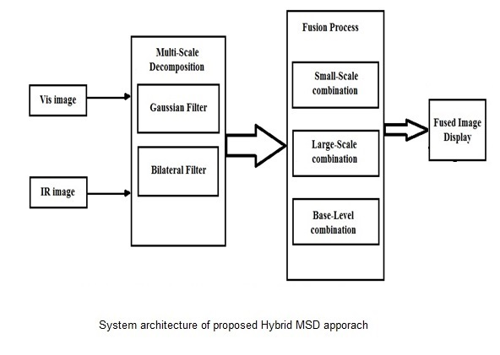
ARCHITECTURE DIAGRAM
Department of Computer Science & Engineering, DSCE

Slide 8
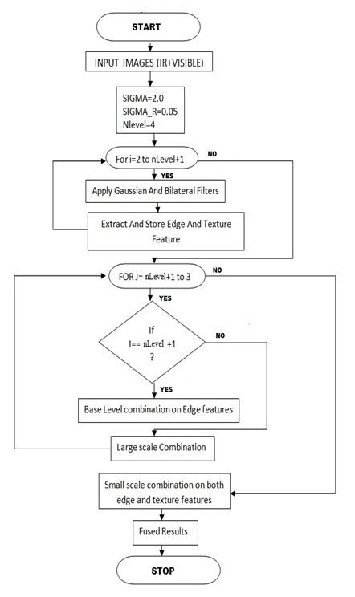
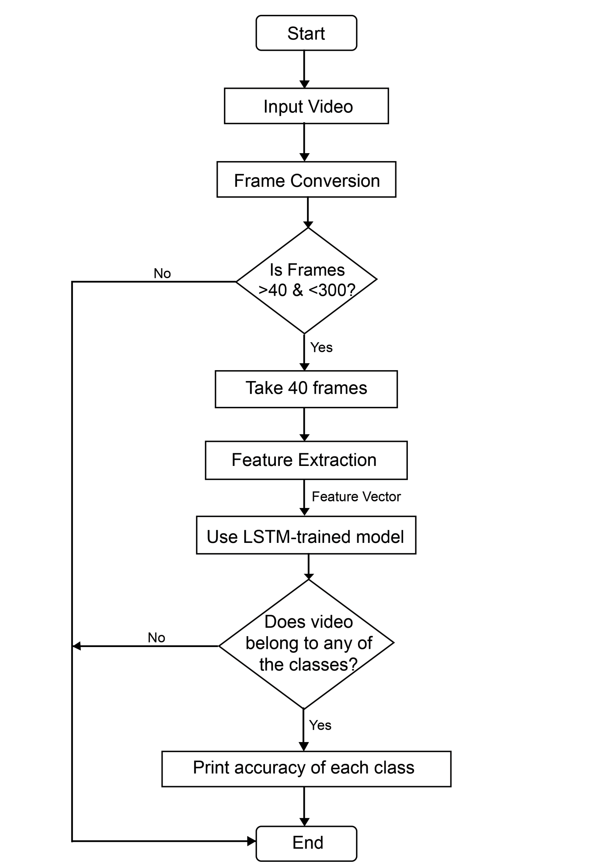
FLOWCHART
Department of Computer Science & Engineering, DSCE

Slide 9
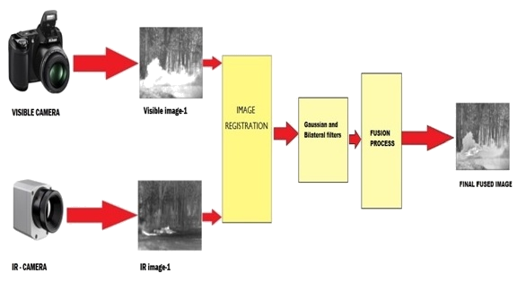
METHODOLOGY
The proposed approach comprises of two steps:
1. MSD based on Gaussian and Bilateral filters
2. Infrared and visible image fusion based on
2.1. Small and large-scale combinations.
2.2. Base level combination.
Department of Computer Science & Engineering, DSCE

Slide 10
METHOLOGY(CONTINUED)
Step 1 Small-Scale combination:
Small scale combination is used to integrate fine-scale features into fused image it is applied to the original image. The value of lambda is used to regulate the amount of IR image features to be injected in the visible image for better visual perception.
Step 2 Large-Scale combination:
The large-scale levels are chosen to include all the decomposed levels. At these scale levels, the decomposed large-scale edge features are fully used to identify and determine the weights of corresponding IR spectral features that would be injected into the visible image.
Step 3 Base-Level combination:
The use of base image in image fusion is that it generally provides the support information for the higher-frequency sub-bands. They are closely associated with each other in scale-spaces. So it is reasonable that the construction of the fused base image would also be related to the higher-level decomposed information in the fusion process.
Department of Computer Science & Engineering, DSCE

Slide 11
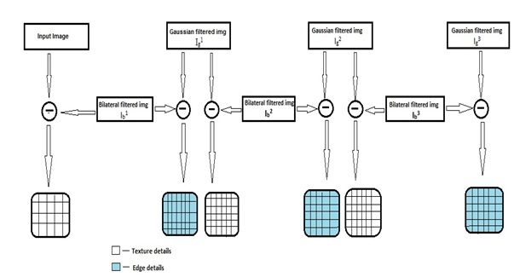
`
Schematic diagram of proposed hybridisation of the MSD method using filters

Slide 12
EXPERIMENTS
We selected few of the standard visible and IR images which are, "meting012", "Road", "T1“, ”Dune”, ”Camp” ,”Road” , etc are been selected from "https://figshare.com/articles/TNO_Image_Fusion_Dataset " to assess the performance of the proposed method.
We considered other two existing methods Stationary Wavelet Tranform (SWT) and Pulse-Coupled Neural Network (PCNN) to compare the performance corresponding to the proposed hybrid MSD method.
The corresponding comparison for different images set and various performance parameter are show in the graphs.
From the Graph and table we can see that the proposed methods in more efficient.
Department of Computer Science & Engineering, DSCE

Slide 13
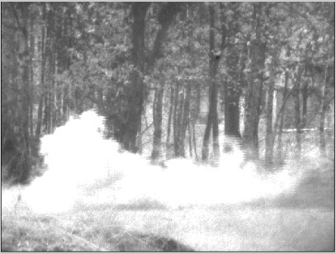
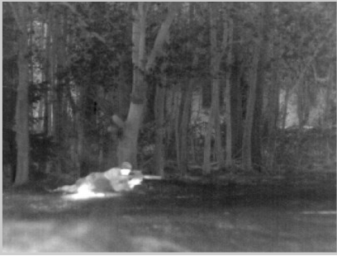
INPUT IMAGES
Visible Image
IR Image

Slide 14
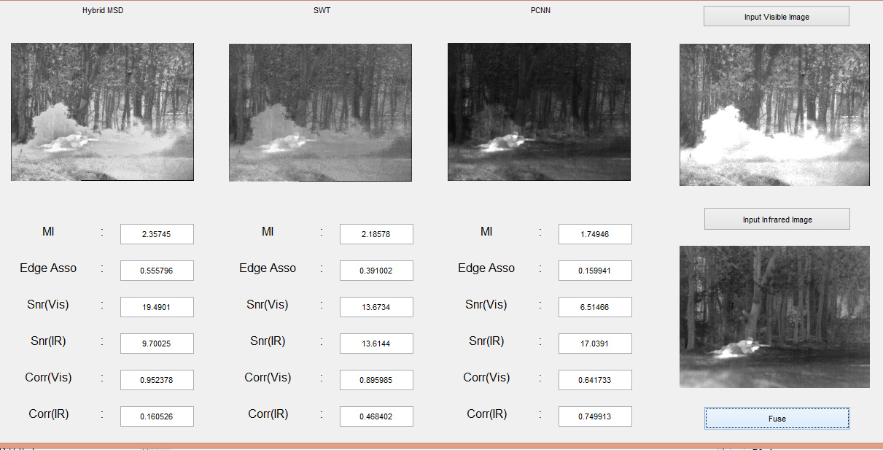
cv
OUTPUT
Department of Computer Science & Engineering, DSCE

Slide 15
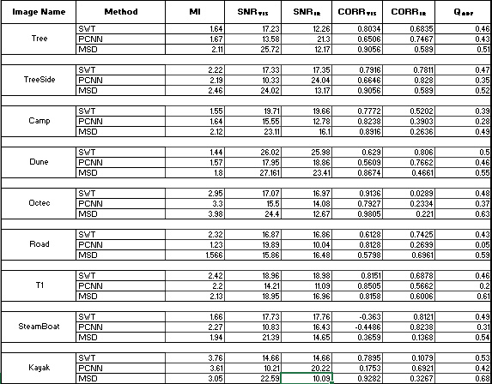
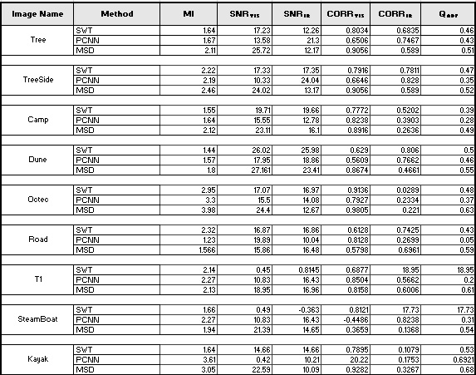

Slide 16
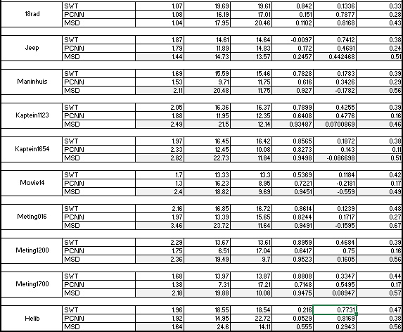

Slide 17
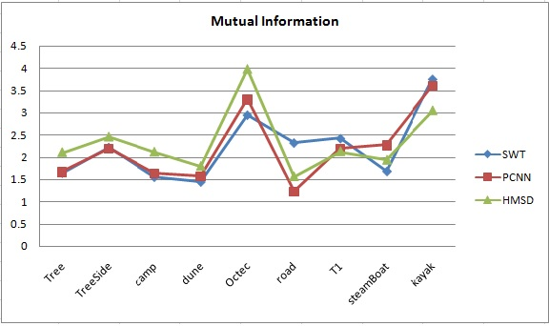
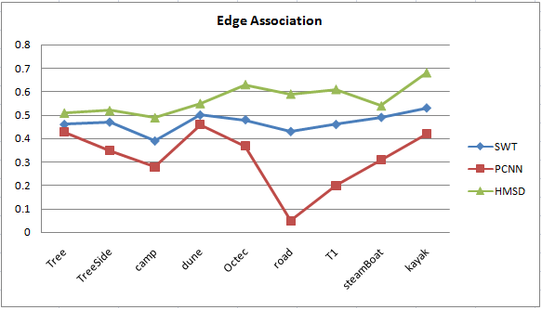
RESULTS
Department of Computer Science & Engineering, DSCE

Slide 18
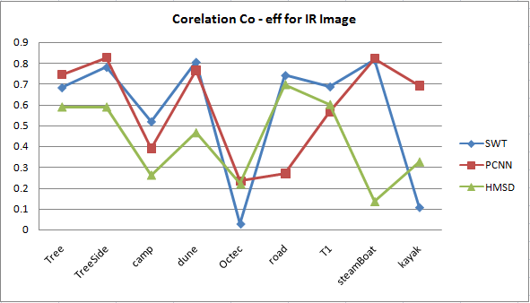
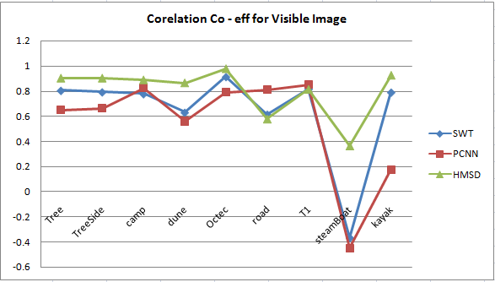
cv
RESULTS
Department of Computer Science & Engineering, DSCE

Slide 19
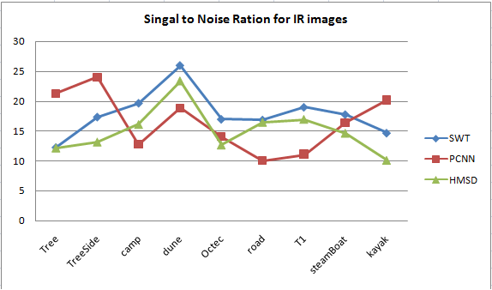
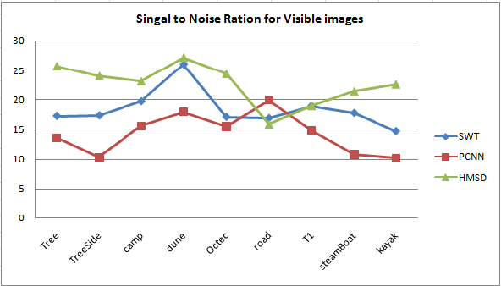
cv
RESULTS
Department of Computer Science & Engineering, DSCE

Slide 20
CONCLUSION
In this project, a novel method to fuse Infrared (IR) and visible images has been proposed based on combining rule for a multi scale decomposition based image fusion.
By further employing different combination algorithms adaptively according to different information scale levels in the fusion process, we can preserve or properly enhance the background scenery and details from the visible image which provide important perceptual cues for human observation.
Experimental results demonstrate that the proposed fusion method is able to provide perceptually better fusion results compared with various other pixel-based multi-scale fusion algorithms.
Department of Computer Science & Engineering, DSCE

Slide 21
REFERENCES
[1] Wei Gan, Xiaohong Wu, Wei Wu, Xiaomin Yang, Chao Ren, Xiaohai He, Kai Liu, "Infrared and visible image fusion with the use of multi-scale edge-preserving decomposition and guided image filter”, ELSEVIER Infrared Physics & Technology, Volume 72, September 2015, Pages 37–51
[2] Y. Chai, H.F. Li, J.F. Qu, "Image fusion scheme using a novel dual-channel PCNN in lifting stationary wavelet domain", ELSEVIER Optics Communications, Volume 283, Issue 19, 1 October 2010, Pages 3591–3602
[3] Weiwei Kong, Longjun Zhang, Yang Lei, "Novel fusion method for visible light and infrared images based on NSST–SF–PCNN", ELSEVIER Infrared Physics & Technology, Volume 65, July 2014, Pages 103–112
[4] Pusit Borwonwatanadelok, Wirat Rattanapitak and Somkait Udomhunsakul, "Multi-Focus Image Fusion based on Stationary Wavelet Transform and extended Spatial Frequency Measurement”, International Conference on Electronic Computer Technology 2009
Department of Computer Science & Engineering, DSCE

Slide 22
REFERENCES (CONTINUED)
[5] Shutao Li, "Multisensor Remote Sensing Image Fusion using Stationary Wavelet Transform: effects of basis and Decomposition Level", International Journal of Wavelets, Multiresolution and Information Processing Volume 06, Issue 01, January 2008
[6] Sukhjinder Kaur, "Noise Types and Various Removal Techniques", International Journal of Advanced Research in Electronics and Communication Engineering (IJARECE) Volume 4, Issue 2, February 2015
[7] Mr. Rohit Verma and Dr. Jahid Ali, "A Comparative Study of Various
Types of Image Noise and Efficient Noise Removal Techniques", International Journal of Advanced Research in Computer Science and Software Engineering Volume 3, Issue 10, October 2013
[8] Yi Wang, Zhonghua Luo, Zhihai Xu, Huajun Feng, Qi Li, Yueting Chen, “Fusion of Infrared and Visual Images Through Multi-scale Hybrid Unidirectional Total Variation”, IEEE International Conference on Signal and Image Processing (ICSIP) 2016.
Department of Computer Science & Engineering, DSCE

Slide 23
THANK YOU
Department of Computer Science & Engineering, DSCE

